Slide 1
Employee Data Analysis using Excel
STUDENT NAME:L.ASWINI
REGISTER NO: UNM143922CZ-A45
DEPARTMENT: COMMERCE (B.COM (GENERAL))
COLLEGE : SHREE CHANDRAPRABHU JAIN COLLEGE, MINJUR

Slide 2
PROJECT TITLE
Employee Performance Analysis using Excel
Employee Performance Analysis using Excel

Slide 3


AGENDA
Problem Statement
Project Overview
End Users
Our Solution and Proposition
Dataset Description
Modelling Approach
Results and Discussion
Conclusion
3/21/2024 Annual Review

Slide 4

PROBLEM STATEMENT
1. Inconisistent employee performance data
2. Identifying pattrens
3. Employee metrics
4. decision making
5. actionable insights

Slide 5

PROJECT OVERVIEW
CONTENT:
•AIM; To streamline employee data analysis using excel tools
•OBJECTIVES; Identify key metrics, analyae trends & provide data - driven insights

Slide 6

WHO ARE THE END USERS?
▪ HR mangers
▪ Team leads & departments heds
▪ company exectives company manager

Slide 7

OUR SOLUTION AND ITS VALUE PROPOSITION
CONTENT:
Implement excel- based data analysis techniques.
Generate automated reports and dashboards.
Enable easy data manipulation and visualization

Slide 8
Dataset Description
CONTENT:
• Data collected from employee records,including performance,attendance,& demographics .
• Number of records,time span,& key variables .

Slide 9

THE "WOW" IN OUR SOLUTION
CONTENT:
Automated reporting : our excel based system automates complex reporting tasks, saving HR managers hours of manual work. Tise enables quick access to insightful data withoout the need for extensive excel expertise.
3/21/2024 Annual Review
9

Slide 10
MODELLING
CONTENT:
~ Data cleaning and preprocessing.
~ Using excel functions for statistical analysis .
~ Visualization using excel charts and pivot tables .
10

Slide 11
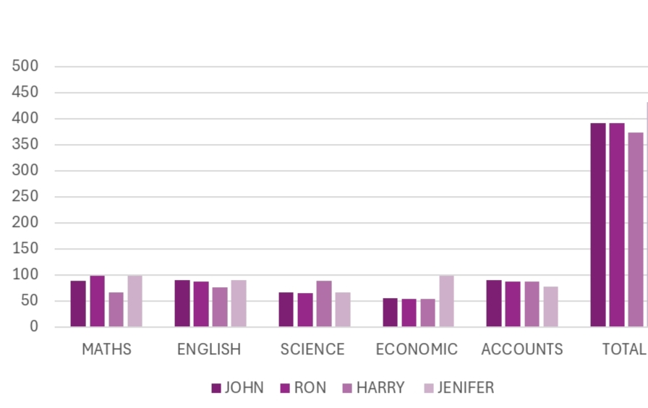
RESULTS
11

Slide 12
conclusion
CONTENT:
∆ Summary of insights gained.
∆ Impact on decision- making and empolyee management.
∆ Future steps for futher analysis or implementation.

